Slide 1



Towards Efficient Automation of Expert Allocation - Approach for SME Triaging
Abhishek Karmakar
Sharik Gazi
Varsha Singh
Indian Institute of Information Technology, Allahabad

Slide 2




Abstract
Subject Matter Experts (SMEs) are individuals possessing deep knowledge and expertise in a specific field or area. In many organisations, effective placement of these experts into appropriate departments is critical for optimising productivity and driving innovation.
The term 'triage' refers to the process of assessing and prioritising cases based on their severity and urgency to ensure that resources are allocated efficiently and where they are needed most. 'SMEs triaging' typically refers to a process in which experts in a particular field or subject evaluate, prioritise, and assign resources or responses to specific issues, challenges, or inquiries based on their knowledge and expertise.
When a person of contact outside an or ganisation raises a concern (question or problem ticket) to the Customer Success Team orthe Customer Success Manager (CSMs), the CSMs need to correctly search for the correct department or the correct SME. We try to automate this process where users don’t know who is the right person of contact having domain specific knowledge.
This research paper delves into the challenge of triaging SMEs to suitable departments using advanced machine learning techniques.
The primary objective of this work is to develop a model that offers better accuracy and efficiency in SME allocation tasks. Five different models were employed - Q-Learning, DQN Classifier, Artificial Neural Network, Support Vector Classifier (SVC) and K-Nearest Neighbour. Of these, SVC exhibited the most promising results. Leveraging this insight, a novel hybrid model was proposed, combining the foundational principles of wrong prediction single batch feedback learning with Support Vector Classifier.

Slide 3

Introduction
In our specific case, we have create our own dataset and conducted our experiments and analyses based on this dataset. Building upon this insight, we introduce a hybrid model, a synthesis of foundational self- learning principles of wrong prediction single batch learning on the Support Vector Classifier based upon feedback. The main aim of this paper is to create an architecture which can learn itself in case of wrong prediction. At first a base model has been trained (among the 5 models, SVC performed the best). The input to the model are problem tickets which are further used for SME triaging purpose. In case the model fails to provide a correct output, the user has to provide a feedback based on which the model re-trains itself on a single batch.
The perspective of a customer service landscape, many individuals face the frustration of navigating complex automated phone systems when they contact companies for assistance. This issue spans various sectors, including e-commerce, banking, fintech, technology, healthcare, and more. Customers are often required to select from a multitude of options or press numerous buttons to reach the correct department, leading to dissatisfaction and potential customer churn. However, our innovative approach offers a solution to this common problem.
This research paper embarks on a significant exploration: the challenge of triaging SMEs of appropriate departments facilitated by the application of advanced machine learning techniques. The primary objective of this endeavour is to craft a model that not only enhances the accuracy but also augments the efficiency of SME allocation tasks. In this pursuit, five distinct models have been employed and assessed - Q-Learning, Deep Q-Network (DQN) Classifier, Artificial Neural Network (ANN), Support Vector Classifier (SVC) and K-Nearest Neighbours.
Extensive experimentation with various encoders and discriminative decoders was conducted, leading to the selection of the most effective combinations. The encoders employed in our testing encompassed a range of options, including Distilbert base nli mean token [12], Sentence Encoder - all-mpnet-base-v2 [13], Sentence Encoder - Multi-qa-mpnet-base-dot-v1 [14], Distilbert Bert Base Uncased [15], Bert Base Uncase [16], Distilroberta-v1 [17], Roberta Model [18], and Universal Sentence Encoder [19]. Complementing these encoders, our decoder choices included Q-Learning, DQN Classifier, Artificial Neural Network, Support Vector Classifier (SVC) and KNN. Notably, the Universal Sentence Encoder paired with the Support Vector Classifier yielded highly promising results.

Slide 4
Our Target in this Paper
In every corporate sector, the role of a Customer Support Manager (CSM) is pivotal, serving as a conduit between various departments and teams. Our research is geared toward empowering CSMs in the realms of customer support, product and finance related issues. We propose an automated triaging method aimed at reducing the workload of CSMs, streamlining the process of selecting the appropriate SME without delay and eliminating human errors.

Slide 5
Our Target in this Paper
We delve into a detailed examination of each model, elucidating their methodologies, and highlighting their transformative potential in reshaping the importance of the deployment of Subject Matter Experts (SMEs) triaging automation solution within organisational frameworks.
Additionally, we explore the significance of real-time feedback mechanisms, temporal considerations, and adaptive learning in refining and optimising the allocation process. In case of wrong output, the model would learn through the feedback.

Slide 6
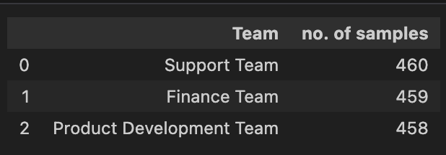
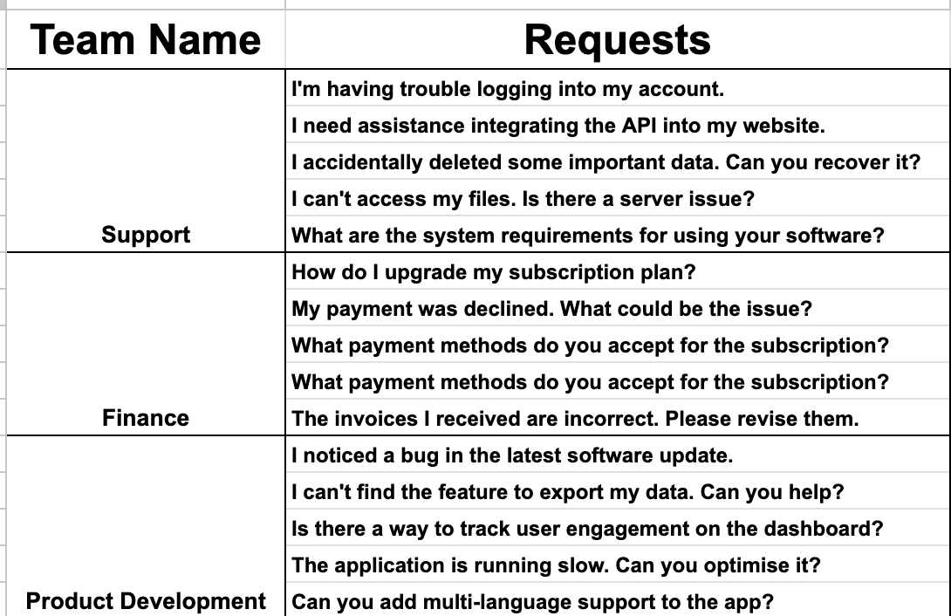
Data Description
For this study, we generated a proprietary sample dataset from our own.
The dataset's outcomes were stored in a JSON format for ease of access and analysis. To ensure unbiased training, an even distribution was maintained, with each class represented by 460 samples approx., specifically curated for Subject Matter Expert Triaging.

Slide 7
Related
Works
1.) Machine Learning Adoption in Small and Medium Enterprises:
Bauer et al. [1] explored ML adaptation in small and medium level industries, revealing a conspicuous lack of robust Data Science management and interdisciplinary collaboration. The study underscores the requisite for ML frameworks that enhance the business success factor by strategically navigating technological enablers and mitigating associated challenges.
2.) Influence and Effectiveness of Subject Matter Experts in Various Contexts:
Research reveals a nuanced relationship between SMEs and their impact on both training and predictive evaluations. Williams [2] delves into the efficacy of SMEs in technical training, exploring how their expertise influences learner outcomes. The authors had explained the effectiveness of assigning the technical professionals (Subject Matter Experts) for training their area of expertise through their skill and knowledge. Through paper, authors tried to explain the influence of tutors on student's effort. They examine problem based learning for academic achievement.
In a focused study at the University of Limburg Faculty of Health Sciences, Schmidt et al. [3] investigated the impact of tutors' subject-matter expertise on student achievement and effort in a problem-based curriculum. The findings reveal a nuanced role of content-expert tutors in boosting student achievement and self-directed study investment, particularly in initial curriculum years.
Another study by Bejar [4] examined SMEs' predictive capabilities concerning the difficulty and determination of items on a Standard English Written Test, revealing that even seasoned experts might fall short of replicating item statistics’ ratings after extensive training. The study examined up to which level the subject matter experts could predict the difficulty and determination of the items on an Standard English Written Test. On a human level the conducted study on 4 subject matter experts suggested that even after an extended period of training and practice does not reach up to a level that would be required to substitute the ratings of item statistics.
Advancements in Artificial Intelligence (AI) and Machine Learning (ML) have significantly impacted various industries, necessitating the incorporation of novel technologies to sustain competitiveness and revenue generation. This section synthesis related studies, illuminating the intersection of AI, ML, and the role of Subject Matter Experts (SMEs) in varied domains.
References:-
Bauer, Markus, Clemens van Dinther, and Daniel Kiefer. "Machine learning in SME: an empirical study on enablers and success factors." (2020).
Williams, Saundra Wall. "The effectiveness of subject matter experts as technical trainers." Human Resource Development Quarterly 12.1 (2001): 91.
Schmidt, Henk G., et al. "Influence of tutors' subject-matter expertise on student effort and achievement in problem-based learning." Academic medicine 68.10 (1993): 784-91.
Bejar, Isaac I. "Subject matter experts' assessment of item statistics." Applied Psychological Measurement 7.3 (1983): 303-310.

Slide 8
Related
Works
3.) Integrating Subject Matter Expertise in Technology and Health Monitoring Systems:
An innovative application of SME in health monitoring is delineated by Dang [1], wherein a deep learning model, enhanced with SME, was developed for equipment health monitoring systems. Utilizing a sliding window strategy, autocorrelation, and partial autocorrelation functions with elbow method, the study successfully identified an optimal window size, contributing to real-time health monitoring. The deep learning model has been trained using the hyperparameter tuning and an optimal set of parameters has been chosen.
Conversely, Robinson [2] presented an application of subject matter expertise in conjunction with Natural Language Processing (NLP) in the aviation safety reporting system database. The topic terms generated from the database are presented to the SME experts to judge the qualification and factors.
4.) Expertise and Knowledge Requirement in Emerging Industries: A Case of Esports:
Kostas [3] navigates the rapidly growing esport industry, identifying requisite knowledge, skills, and abilities for aspiring professionals. Engaging subject matter experts through interviews, the study aimed to map essential competencies, guiding career trajectory in esports by aligning potential industry professionals with emerging career opportunities. The overarching objective was to delineate the requisite expertise and capabilities that potential esport industry professionals should possess to align with the career opportunities in the field.
5.) Elevating Model Validation through Hybrid Approaches:
Teferra et al. [4] pioneered a hybrid model validation approach, weaving quantitative validation metrics (consisting of scalar values) with qualitative subject matter expert (SME) evaluations via a Probabilistic Neural Network (PNN). The model effectively formalised relationships between input validation metrics and output SME scores as a classification problem using PNN classifiers and various validation metrics to quantitatively represent SME judgement, demonstrating its applicability in varied model validation contexts such as real-world shock qualification testing.
References:-
Dang, Jr-Fong. "The deep learning-based equipment health monitoring model adopting subject matter expert." International Journal of Computer Integrated Manufacturing (2023): 1-16.
Robinson, S. D. "Temporal topic modeling applied to aviation safety reports: A subject matter expert review." Safety science 116 (2019): 275-286.
Karadakis, Kostas, and Maria Manus Painchaud. "Esport Knowledge, Skills, and Abilities: Perspectives from Subject Matter Experts." Athens Journal of Sports 9.2 (2022): 79-100.
Teferra, Kirubel, et al. "Mapping model validation metrics to subject matter expert scores for model adequacy assessment." Reliability Engineering & System Safety 132 (2014): 9-19.

Slide 9
Related
Works
6.) Promoting Transparency and Inclusivity in AI Technologies:
Christianto et al. [1] introduced the Smart Interpretable Model (SIM) framework, which champions transparency in AI technologies by formulating comprehensible fuzzy IF-THEN rules and membership functions, without necessitating advanced AI knowledge from users. SIM allows users to embed their prior knowledge throughout its application, facilitating nuanced insights into anomalous rules and feature contributions while ensuring trust and understanding in its predictive capabilities. Utilizing various datasets, SIM’s performance and generated rules are validated against contemporary rule-based models, demonstrating its efficacy and versatility.
7.) Knowledge Acquisition and Expert-Agent Interaction:
Lastly, Tecuci et al. [2] explored a knowledge-acquisition experiment where subject matter experts, devoid of prior knowledge-engineering experience, successfully instruct the Disciple-COA agent in critiquing courses of action - a challenge identified by DARPA's High-Performance Knowledge Bases program. It elucidates the COA problem, Disciple-COA architecture, expert-agent interaction, and automated knowledge-base development. The experiment’s success substantiates the efficacy of the Disciple approach in addressing knowledge acquisition bottlenecks.
References:-
Christianto, Hotman, et al. "Smart interpretable model (SIM) enabling subject matter experts in rule generation." Expert Systems with Applications 207 (2022): 117945.
Tecuci, Gheorghe, et al. "An experiment in agent teaching by subject matter experts." International Journal of Human-Computer Studies 53.4 (2000): 583-610.

Slide 10
Comparison and gaps between other related works and our proposal
Related Research Papers | Comparison with our work
Bauer et al. [1] delineates the indispensable role of AI in tackling market-related issues in organisations, the need of adopting Artificial Intelligence today in the organisations by analysing the problems related to market issues. While it underscores the exigencies of adopting AI, our work further augments this by offering a pragmatic approach to implementing AI in SME fields. | Our paper also presents a way to implement AI in the field of SME. While the work in [1] underscores the exigencies of adopting AI, our work further augments this by offering a pragmatic approach to implementing AI in SME fields.
Williams [2], the pivotal role of SMEs in enriching knowledge delivery is highlighted. The authors advocate for the necessity of SMEs had explained the need of Subject Matter Experts for excellent delivery of knowledge and skill set. | Our work extends this discussion by presenting an automated mechanism for efficient Subject Expert allocation automation.
Schmidt et al. [3] underscore the significance of problem-based learning, employing subject-matter knowledge to shepherd academic students through their learning journey. The study is an analysis on problem based learning that has been done to use their subject-matter knowledge to guide academic students. | While our research orbits a similar thematic nucleus of subject-matter knowledge, it distinctively pivots toward an intensive exploration of triaging automation
Bejar [4] offers insight into establishing a threshold for pretesting item statistics at a human level. | In contrast, our paper introduces a methodology featuring a machine learning model designed to incrementally learn and adapt over time.
While [5] articulates a deep learning framework tailored for real-time health monitoring ML model by integrating subject matter expertise. | Our research pivots towards addressing issues pertinent to finance, support, and product domains, employing akin architectural strategy. Furthermore, our work introduces a novel methodology, underscoring a dynamic approach to hypothesis modification.
In the methodology articulated by Robinson [6], subject identification unfolds through a two-stage process: initially, topics are generated from samples within the aviation database, subsequently, conceptual themes are identified by Subject Matter Experts (SMEs). | Contrarily, our paper proposes a streamlined, singular step approach. By introducing a single sample, our method autonomously suggests the pertinent Subject Expert Department.
Kostas' investigation into esports, as documented in study [7], underscores the imperative of identifying and illuminating the pivotal knowledge, skills, and abilities (KSAs) indispensable for pursuing careers within the burgeoning esport industry. This is achieved by harnessing expert insights to delineate vital expertise and capacities, ensuring alignment with the ever-evolving demands of the industry. | In contrast, our work pivots towards training the model to mature into a subject matter expert, encapsulating a distinct, yet complementary, avenue of exploration in the area of expertise towards finance, support and product.
Teferra et al. [8] concentrated their efforts on developing an efficient Subject Matter Expert (SME) score, which serves as an evaluative mapping for model appraisal, that is, an efficient SME score as a scoring map for model evaluation. | Contrarily, our research pivots toward identifying the apt Subject Matter Expert, and not generating predicted scores on the extent and level of subject knowledge.
The methodology employed by Christianto et al. [9] centres on the utilisation of IF-THEN rules within a fuzzy logic framework. | Instead our research adopts a machine learning-oriented approach. We explore various models with a keen emphasis on enabling the devised model to proficiently operate across diverse environments and accommodate assorted test cases.
Tecuci et al. [10] explore the realm of interaction-based knowledge base development, with a distinct emphasis on facilitating subject matter experts in instructing a learning agent. This process is pivotal for the effective acquisition of a knowledge base. | Contrasting this, our research steers its focus toward the execution of knowledge transfer from a technical vantage point, specifically employing machine learning and deep learning methodologies.

Slide 11
Proposed
Work
We provided a comprehensive overview of the suggested model's architecture for the analysis of algorithms on the job of request triaging procedures inside a corporate ecosystem. Our approach centres around training a base model capable of accurately triage ticket requests. We then employ a single batch learning strategy to continually enhance the model's performance by correcting any erroneous predictions.
5 distinct classification algorithms plays a pivotal role in our methodology. These algorithms serve as the foundation for our base model, enabling it to efficiently categorise ticket requests.
These models are developed and tested to see how well they distribute incoming tickets to the appropriate departments. The goal was to make it easier for subject matter experts to efficiently resolve client inquiries. The study revealed that the Support Vector Classifier (SVC) produced the best outcomes in terms of the relevant evaluation measures.

Slide 12
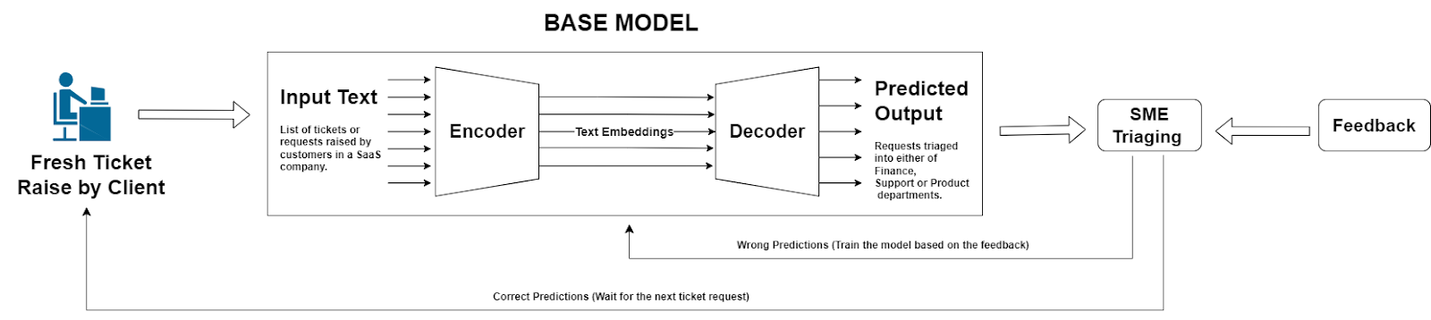
Proposed Methodology
The basic model is used by the SME for triaging new tickets that are raised by clients. After making incorrect predictions, the Customer Success Manager may offer input that helps the model improve and make more accurate classifications in the future.
The encoder performs the operation of creating a text embedding and the decoder is a classifier model which discriminates among which of the following classes (Finance, Product and Support) it belongs.
The encoders employed in our testing encompassed a range of options, including Distilbert base nli mean token [12], Sentence Encoder - all-mpnet-base-v2 [13], Sentence Encoder - Multi-qa-mpnet-base-dot-v1 [14], Distilbert Bert Base Uncased [15], Bert Base Uncase [16], Distilroberta-v1 [17], Roberta Model [18], and Universal Sentence Encoder [19]. Complementing these encoders, our decoder choices included Q-Learning, DQN Classifier, Artificial Neural Network, Support Vector Classifier (SVC) and KNN.
Notably, the Universal Sentence Encoder paired with the Support Vector Classifier yielded highly promising results.

Slide 13
Q - Learning for Classification
Q-learning is a model-free RL algorithm used to learn an optimal policy for an agent interacting with an environment to maximise its cumulative reward over time. The Q-value represents the expected cumulative reward that an agent can achieve by taking a particular action from a specific state and then following the optimal policy thereafter. Q-learning isn't typically used for classification problems directly but in order to frame the classification task in the reinforcement learning context, an environment needs to be created where the agent can interact, receive rewards based on its actions (predictions), and update its policy (Q-values).
Implementing Q-learning for text classification is non-trivial, but here's a high-level overview:
State: Each text sample can be a state.
Action: Predicting a class (Support Team, Finance Team, Product Development Team) can be an action.
Reward: If the prediction is correct, give a positive reward. If it's wrong, give a negative reward.
In order to select the optimal number of epochs, the Early Stopping method has been used. For implementing Early Stopping, we keep a track of the validation loss and stop training until it reaches a state where it doesn't improve for a certain number of epochs. In this case, the loss is defined by the Q-learning update formula, and validation loss can be considered as the total negative rewards on the validation set.
Here's implementation of early stopping:
Split the data into training, validation, and test sets.
During training, evaluate on the validation set every epoch.
If the validation loss doesn't improve for a certain number of epochs (patience), stop training.
The Q-learning update rule is given by the equation: Q(s, a) = Q(s, a) + alpha * [r + gamma * max_a' Q(s', a') - Q(s, a)], where Q(s, a) is the current Q-value of the state-action pair, alpha is the learning rate, r is the reward for taking, action a in state s, gamma is the discount factor, max_a' Q(s', a') is the maximum Q-value for the next state s' over all possible actions a'.

Slide 14
DQN Classifier
DQN, which stands for Deep Q-Network, is a fundamental approach in reinforcement learning (RL) that combines deep learning techniques with the Q-learning algorithm.
Here's a step-by-step explanation of the DQN approach:
Experience Replay: DQN employs an experience replay buffer to store a history of agent experiences (state, action, reward, next state). This replay buffer breaks the temporal correlation between consecutive experiences, making the learning process more stable.
Q-Network Architecture: DQN uses a deep neural network as its Q-network. The input to the network is the current state, and the output is a vector of Q-values for all possible actions in that state.
Target Q-Network: To stabilise the learning process and address the issues of moving targets in traditional Q-learning, DQN introduces a target Q-network. This network is a copy of the Q-network but with frozen weights that are updated periodically. The target Q-network is used to compute the target Q-values for the Bellman update.
Loss Function and Training: The loss function for DQN is typically the mean squared error between the predicted Q-values by the Q-network and the target Q-values generated using the Bellman equation. The Bellman equation calculates the expected Q-value considering the immediate reward and the maximum Q-value from the next state according to the target Q-network.
Exploration Strategy: DQN employs an exploration strategy, often epsilon-greedy, to balance the exploration of new actions and exploiting the current knowledge.
Training Process: During training, the DQN algorithm samples batches of experiences from the replay buffer. For each batch, it calculates the loss and updates the Q-network's weights using gradient descent. The target Q-network's weights are updated less frequently to stabilise the learning process.

Slide 15
Artificial Neural Network
The Neural Network is used for multi-class classification on the SME dataset. The network structure consists of multiple layers, with each layer containing a set number of neurons. Between layers, operations like BatchNormalization and Dropout are employed. BatchNormalization helps in achieving a stable learning process by normalising the activations of the neurons, while Dropout prevents overfitting by randomly setting a fraction of input units to 0 during training. The activation functions like 'relu' and 'softmax' determine the output of each neuron. The model is trained using the 'adam' optimizer and 'categorical_crossentropy' as the loss function, which is standard for multi-class classification tasks. After training, the model's performance is evaluated based on its accuracy on a test dataset, and a detailed classification report is generated. In essence, this Neural Network is a multi-layered computational model trained to classify data points in the SME dataset into one of three categories.

Slide 16
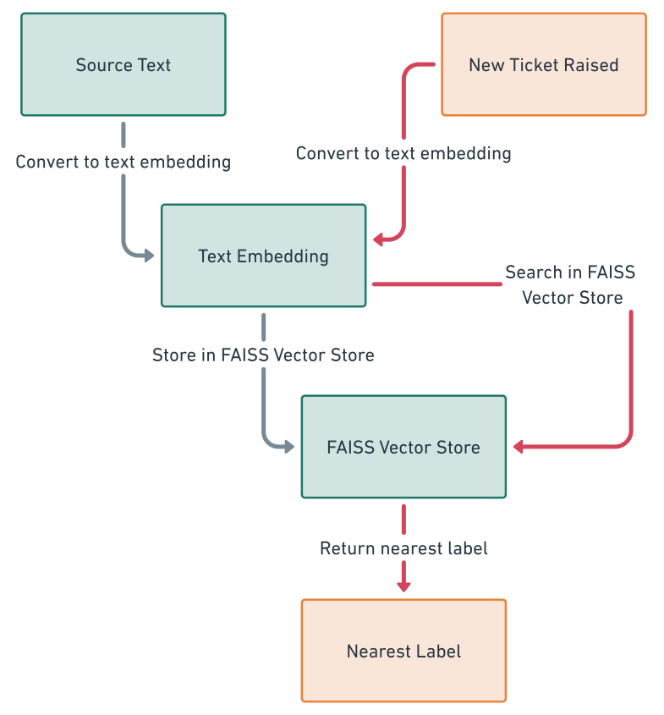
K-Nearest Neighbour
For the classification purpose, KNN algorithm is one of the most efficient algorithm. KNN classifies the data based on the nearest similar point. To efficiently manage and retrieve embeddings, a FAISS vector store is utilized as its very efficient in similarity searches. FAISS allows the creation of indexes to organize and search through vectors efficiently and its faster vectors in a collection that are most similar to a query vector. The FAISS index is created to store the embeddings, providing a mechanism for fast and accurate k-nearest neighbour searches. The KNN search is employed for text classification. Given an input sentence, the text encoder generates an embedding, which is then used to query the FAISS index. The KNN search identifies the nearest neighbours, allowing for the classification of the input text based on the metadata associated with these neighbours.
Vector Stores indexes and store vector embeddings for fast retrieval and similarity searches.

Slide 17
Support Vector Machine
In our methodology, we employed a Support Vector Classifier (SVC) and refined its performance via hyperparameter optimization. Subsequent to the training phase, we tested the model's robustness and adaptability by introducing it to single-sentence predictions. Upon receiving an input sentence, the SVC predicts an output; if this output is judged incorrect by the user, immediate feedback is solicited regarding the correct classification. In cases where the model's prediction was incorrect, we instituted an interactive feedback mechanism: the user was prompted to provide the correct output. The model was then fine-tuned further by training it on this single-instance feedback batch. When the model undergoes a rapid retraining phase using this singular data instance, thereby incorporating the newfound knowledge.

Slide 18
Using the Pre-training model for Single Sentence Prediction
We illustrate the process of training a classification model for triage tasks. An evaluation of five distinct models is presented in Result Section, with the Support Vector Machine (SVM) emerging as the top-performing choice when paired with the Universal Sentence Encoder. Consequently, we have preserved this well-performing SVM model for future use in classification of the corporate requests raised by the customers.
Additionally, we implemented a feature that prompts users for immediate feedback regarding the model's prediction accuracy. The user (CSMs) is prompted to provide a brief response about the accuracy of the forecast. To help the algorithm learn from incorrect predictions, we ask the user for the proper label output.
We introduced the idea of using feedback based learning for training on a specific batch of data. This batch comprises 10 random samples from finance team, product development team, and support team labels, in addition to a single wrong predicted output, totalling a batch size of 31. This strategy aids in mitigating the risk of model overfitting, as elucidated in Table.

Slide 19
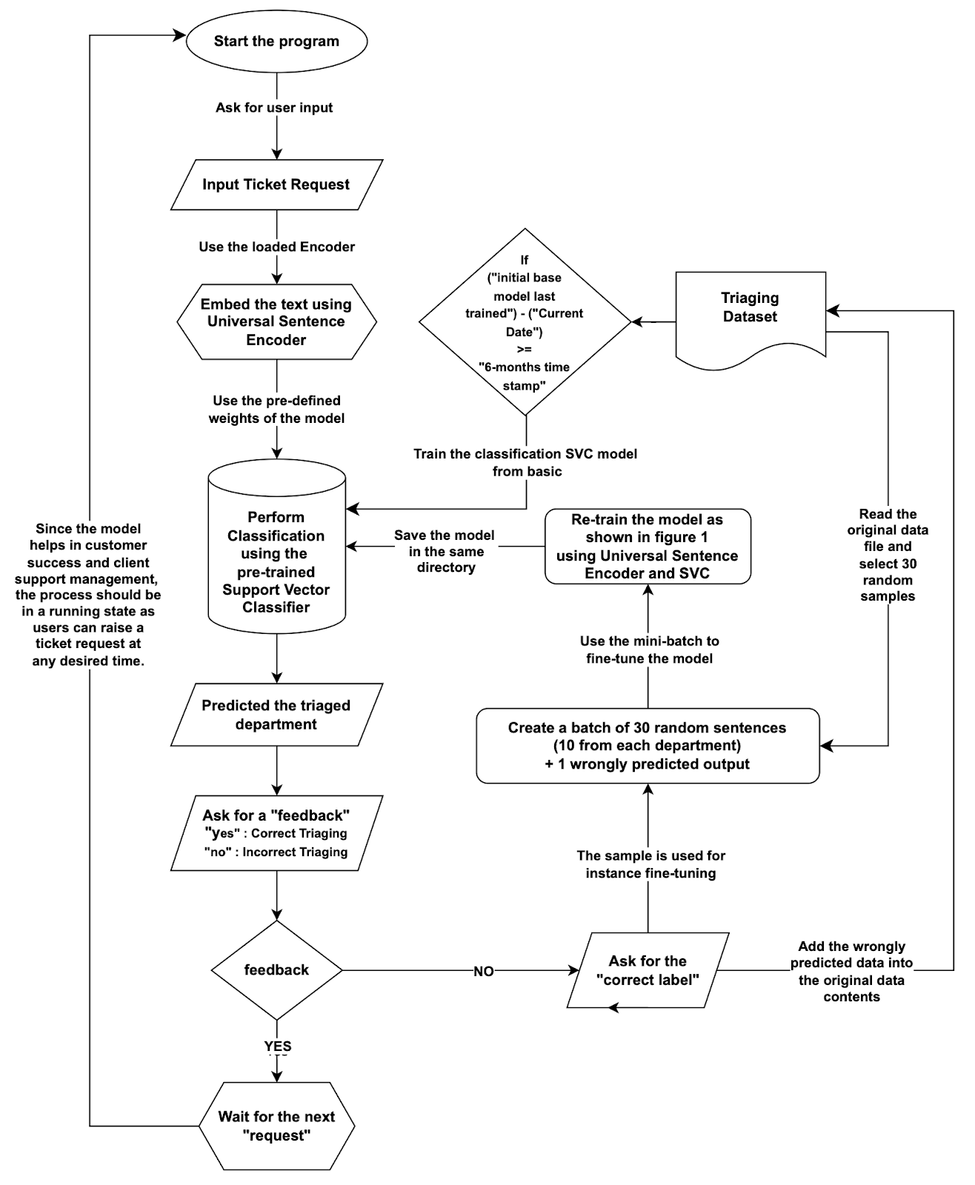
Overall Architectural Diagram

Slide 20
Justify the reason behind choosing a batch size to re-train a pre-trained model and to analyze different strategies for retraining a model based on new or corrected data
Different Strategies for re-training the model | Advantage | Disadvantage
Strategy 1 - Retraining on the Whole Dataset | The model gets refreshed with the entire dataset, which ensures that it retains the knowledge it has previously gained. Useful if the dataset isn't large, as training might not take a significant amount of time. | Can be computationally expensive and time-consuming as the dataset grows. Redundant computations for the instances that the model has already seen.
Strategy 2 - Retraining Only on the New Data Instance | Very fast, as there exists only one instance for training. | The model might forget the previous data. If the new data is noisy or an outlier, the model might become biased towards it.
Strategy 3 - Retraining on a Batch (a mix of old and new data) - current approach | A balance between retraining on the whole dataset and just the new instance. Can incorporate recent feedback while also revisiting older data to prevent forgetting. | The choice of batch size and which old data to include might need experimentation. Some computational overhead, though not as much as retraining on the entire dataset.

Slide 21
Strategy 3 Preferred over Strategy 1,2
When dealing with a smaller dataset, employing the retraining approach on the entire dataset (strategy 1) can yield satisfactory results. Conversely, when dealing with a large dataset but facing computational limitations, one might opt for batch retraining (strategy 3). In this approach, a recent data batch, inclusive of new feedback, is combined with randomly selected older data. This approach guarantees a seamless integration of recent feedback with established knowledge.
In practical scenarios, especially those involving substantial datasets, a batch-wise or mini-batch update is often favoured. This strategy strikes a balance between infusing the model with new data and preserving the foundational knowledge derived from the initial, larger dataset.

Slide 22
Time-Stamp Consideration
Over time, there is a significant likelihood that our underlying hypothesis may evolve. This evolution can be driven by various factors, including:
Shifts in Product Design - Changes in the fundamental structure, features, or aesthetics of the product can lead to shifts in user expectations and experiences.
Terminological Updates - Alterations in the language or terminology used within the product, such as updates to user interface labels or the introduction of new industry-specific terms, can impact user interactions and feedback.
Ideological Adjustments - Evolving company philosophies, mission statements, or core values can influence the way the product is perceived and used by both customers and the organisation itself.
Functional Modifications - Adjustments to the product's functionalities, such as the addition of new features or improvements to existing ones, can change the user interaction patterns and feedback generated.
Market Dynamics - External factors like shifts in market trends, competitive landscape, or emerging technologies can necessitate changes in the product to remain relevant and competitive.
User Feedback and Behaviour - Ongoing user feedback and behaviour patterns can provide valuable insights into areas where the product may need adjustments or enhancements.

Slide 23
Time-Stamp Consideration
In our specific context, we have chosen a 6-month time duration for model retraining. This interval allows for a comprehensive grasp of evolving product dynamics and user feedback. However, the optimal time period can vary depending on the organisation's nature. For instance, in a dynamic startup environment where product changes occur frequently, a shorter 2-month time period may be more suitable. Conversely, in a larger and more stable MNC setting, a 1-year time period might be appropriate, allowing ample time to observe structural, use case, and feature changes along with corresponding shifts in our underlying hypothesis.
Neglecting to set a time period carries the risk of overfitting the model to recent data. This can lead to potential biases, especially when users repeatedly input similar feedback, potentially skewing the model's performance. Due to same class user input feedback, the model might get biased. For any ML model, the dataset always needs to be balanced, whereas in this case the model might get biased.

Slide 24
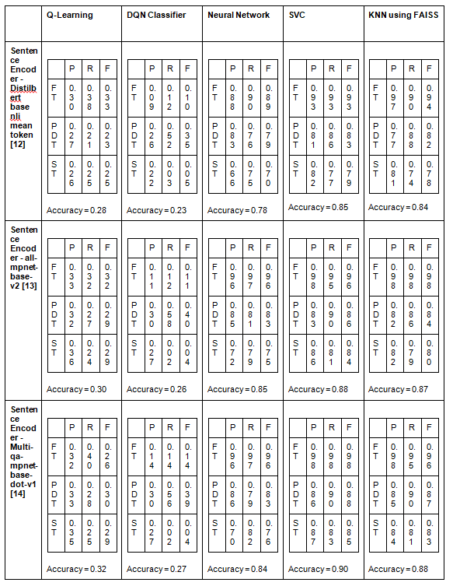
Demonstration of classification reports generated for the various encoders and decoders (discriminative classifiers) used in the paper

Slide 25
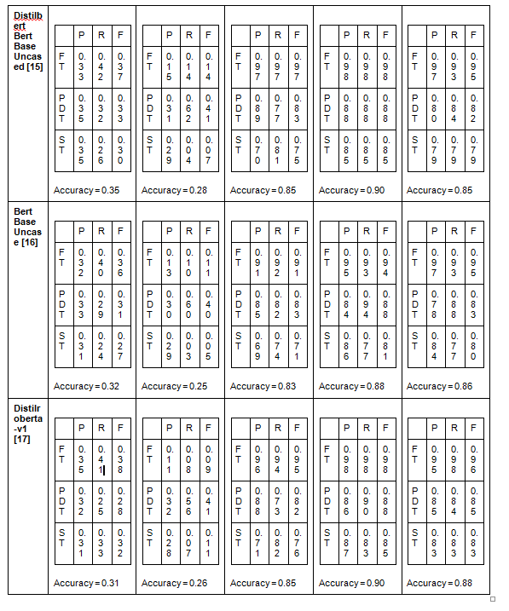
Demonstration of classification reports generated for the various encoders and decoders (discriminative classifiers) used in the paper

Slide 26
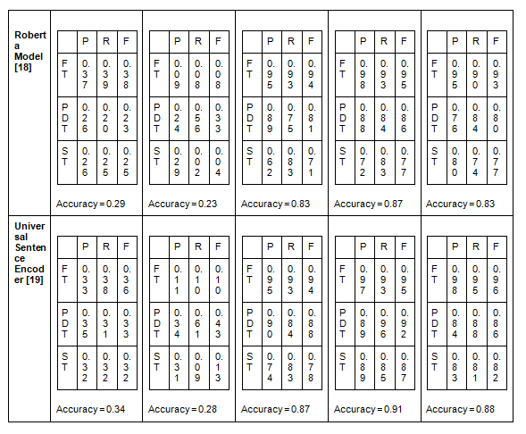
Demonstration of classification reports generated for the various encoders and decoders (discriminative classifiers) used in the paper

Slide 27
Approx. Time Taken by Decoder to train after Universal Sentence Encoder [19] text embeddings
Discriminator Network | Approx. Average hours taken to train the model
Q-Learning | 1.13
DQN Classifier | 4.68
Neural Network | 0.18
K-Nearest Neighbour | 0.001
Support Vector Classifier | 0.11

Slide 28

Conclusion
This paper deals with the dynamic realm of harnessing Subject Matter Experts (SMEs) for organizational success and innovation in the age of rapid technological advancements. We embarked on a significant exploration by developing and accessing five distinct models - Q-Learning, Deep Q-Network (DQN) Classifier, Artificial Neural Network (ANN), Support Vector Classifier (SVC) and KNN - to efficiently allocate SMEs to suitable departments. Our hybrid model, blending feedback learning principles with SVC, emerged as a potential paradigm shift, bridging cutting-edge technology with domain-specific expertise.
Support Vector Classifier has performed better because it is inherently suited for classification tasks and might have been better configured for the problem at hand.
We introduced instance learning to address the challenge of classifying support-related and product-related tickets, empowering Customer Support Managers (CSMs) in their pivotal roles. Moreover, we underscored the significance of timely model updates, which serve to prevent inaccuracies and enhance decision-making. Our research remains adaptable to evolving factors such as product design, terminology, ideology, functionality, market dynamics, and user feedback. Setting a timestamp for periodic model retraining ensures continued relevance and effectiveness.

Slide 29
References
Bauer, Markus, Clemens van Dinther, and Daniel Kiefer. "Machine learning in SME: an empirical study on enablers and success factors." (2020).
Williams, Saundra Wall. "The effectiveness of subject matter experts as technical trainers." Human Resource Development Quarterly 12.1 (2001): 91.
Schmidt, Henk G., et al. "Influence of tutors' subject-matter expertise on student effort and achievement in problem-based learning." Academic medicine 68.10 (1993): 784-91.
Bejar, Isaac I. "Subject matter experts' assessment of item statistics." Applied Psychological Measurement 7.3 (1983): 303-310.
Dang, Jr-Fong. "The deep learning-based equipment health monitoring model adopting subject matter expert." International Journal of Computer Integrated Manufacturing (2023): 1-16.
Robinson, S. D. "Temporal topic modeling applied to aviation safety reports: A subject matter expert review." Safety science 116 (2019): 275-286.
Karadakis, Kostas, and Maria Manus Painchaud. "Esport Knowledge, Skills, and Abilities: Perspectives from Subject Matter Experts." Athens Journal of Sports 9.2 (2022): 79-100.
Teferra, Kirubel, et al. "Mapping model validation metrics to subject matter expert scores for model adequacy assessment." Reliability Engineering & System Safety 132 (2014): 9-19.
Christianto, Hotman, et al. "Smart interpretable model (SIM) enabling subject matter experts in rule generation." Expert Systems with Applications 207 (2022): 117945.
Tecuci, Gheorghe, et al. "An experiment in agent teaching by subject matter experts." International Journal of Human-Computer Studies 53.4 (2000): 583-610.
White, Jules, et al. "A prompt pattern catalog to enhance prompt engineering with chatgpt." arXiv preprint arXiv:2302.11382 (2023).
Hugging face [online]. https://huggingface.co/sentence-transformers/distilbert-base-nli-mean-tokens [Accessed: 15/10/2023]
Hugging face [online]. https://huggingface.co/sentence-transformers/all-mpnet-base-v2. [Accessed: 15/10/2023]
Hugging face [online]. https://huggingface.co/sentence-transformers/multi-qa-mpnet-base-dot-v1. [Accessed: 15/10/2023]
Hugging face [online]. https://huggingface.co/distilbert-base-uncased. [Accessed: 15/10/2023]
Hugging face [online]. https://huggingface.co/bert-base-uncased. [Accessed: 15/10/2023]
Hugging face [online]. https://huggingface.co/sentence-transformers/all-distilroberta-v1. [Accessed: 15/10/2023]
Hugging face [online]. https://huggingface.co/roberta-base. [Accessed: 15/10/2023]
TensorFlow [online]. https://www.tensorflow.org/hub/tutorials/semantic_similarity_with_tf_hub_universal_encoder. [Accessed: 15/10/2023]
Langchain [online]. https://python.langchain.com/docs/get_started/introduction. [Accessed: 06/01/2024]

Slide 30
Thank You !!

